Slide 1
Stock Market Analysis
Presentation by Pawan Rama Mali

Slide 2
Stock Report
Symbol | Week | Month | Quarter | Year | All
AAPL | 5.52% | 27.1% | 82.3% | 160% | 223%
FB | 9.16% | 19.7% | 58.6% | 77% | 116%
GOOG | 3.96% | 5.0% | 28.8% | 34% | 57%
NVDA | 8.29% | 25.1% | 85.3% | 187% | 288%

Slide 3
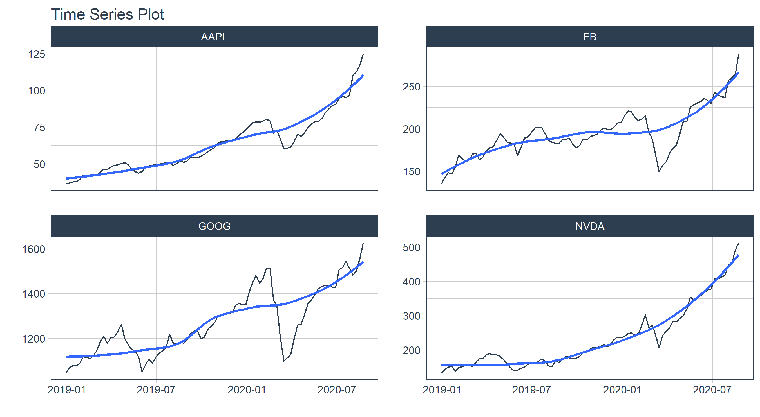
Stock Graph

